Slide 1


Introduction to ChatterBot
ChatterBot is a powerful open-source Python library that allows developers to create conversational AI chatbots. It provides a framework for building and training chatbots, making it easier to develop natural language processing applications.
sr

Slide 2

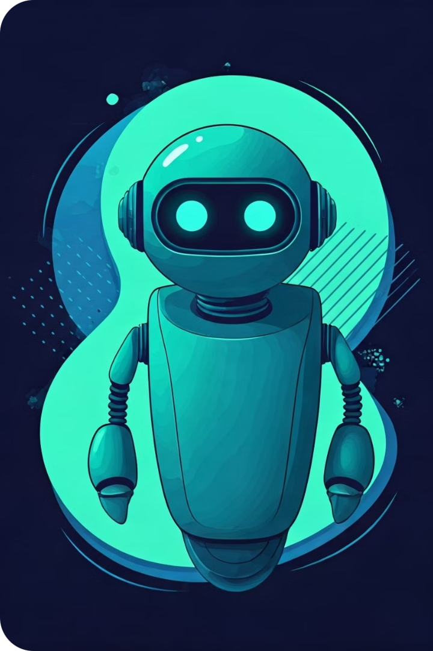
What is a Chatbot?
Conversational AI
A chatbot is an artificial intelligence program designed to simulate human conversation, allowing users to interact with a computer system as if they were talking to another person.
Natural Language Processing
Chatbots use natural language processing (NLP) techniques to understand and respond to user input, making the interaction feel more natural and human-like.
Broad Applications
Chatbots can be used for a variety of purposes, such as customer service, personal assistants, and even educational or entertainment applications.

Slide 3

Benefits of Building a Chatbot
1
Improved Customer Experience
Chatbots can provide instant, 24/7 support, improving customer satisfaction and reducing response times.
2
Increased Efficiency
Chatbots can handle routine tasks and queries, freeing up human staff to focus on more complex issues.
3
Scalability and Cost Savings
Chatbots can handle a large volume of interactions simultaneously, without the need for additional human resources.
4
Continuous Learning
Chatbots can learn from each interaction, improving their responses and becoming more intelligent over time.

Slide 4

Getting Started with ChatterBot
Installation
Training
Begin by installing the ChatterBot library using pip: pip install chatterbot
Train the chatbot with conversational data to improve its understanding and responses.
1
2
3
Configuration
Set up the language and logic adapters to define the chatbot's behavior and response capabilities.

Slide 5
Importing and Initializing ChatterBot
Importing the Library
Initializing the Chatbot
Configuring the Chatbot
Start by importing the necessary components from the ChatterBot library:
Create an instance of the ChatBot class, specifying a name and the language model to use:
Set the chatbot's behavior and response logic by selecting the appropriate logic adapters.
from chatterbot import ChatBot
from chatterbot.trainers import ListTrainer
chatbot = ChatBot('MyBot',
logic_adapters=['chatterbot.logic.BestMatch'],
language='en')

Slide 6




Defining the Chatbot's Response Logic
Input Processing
Response Generation
Continuous Improvement
Analyze the user's input and determine the appropriate response.
Generate a relevant and coherent response based on the chatbot's training data.
Continuously refine the chatbot's understanding and response capabilities through ongoing training.

Slide 7
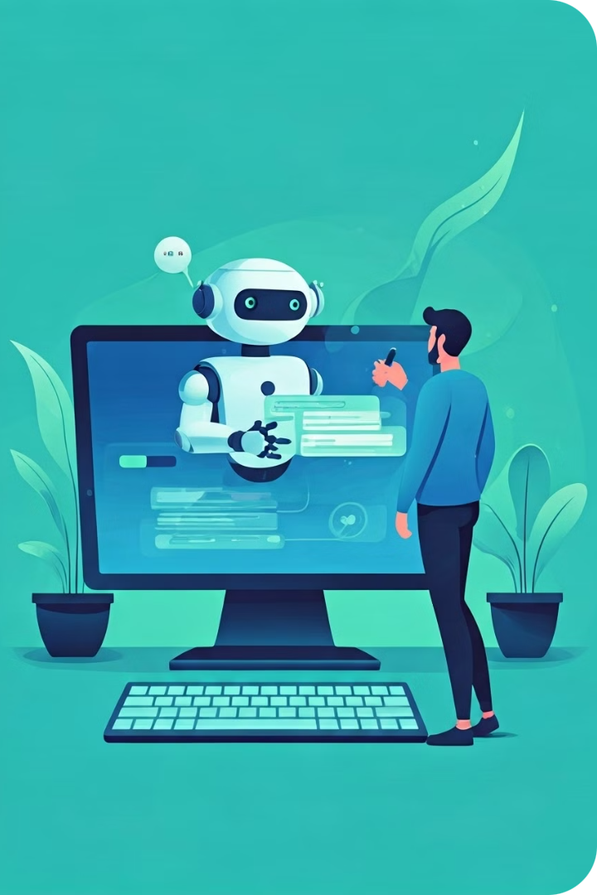



Training the Chatbot with Conversation Data
Collect Data
Gather a diverse set of conversational data, such as chat logs, FAQs, or scripted dialogues.
Preprocess Data
Clean and format the data to ensure it's compatible with the ChatterBot training process.
Train the Chatbot
Use the ListTrainer class to train the chatbot on the prepared conversation data.

Slide 8

Integrating the Chatbot with a User Interface
User Input
Chatbot Response
Hello, how can I help you today?
Hi there! I'm here to assist you with any questions or concerns you may have. How can I be of service?
I'm looking for information about your product features.
Great, I'd be happy to provide you with details about our product features. What would you like to know specifically?
Can you tell me about the pricing options?
Certainly, our pricing options are quite flexible. We offer a range of plans to suit different budgets and needs. Let me know if you have any specific requirements and I can provide more details.

Slide 9

Deploying and Hosting the Chatbot
1
Cloud Hosting
Deploy the chatbot on a cloud platform like AWS, Azure, or Google Cloud, which provides scalable infrastructure and easy integration with other services.
2
Containerization
Package the chatbot application and its dependencies into a Docker container for easy deployment and portability.
3
Conversational Platforms
Integrate the chatbot with popular messaging platforms like Slack, Discord, or Facebook Messenger to reach a wider audience.

Slide 10
Conclusion and Next Steps
Continuous Improvement
Expanding Functionality
Exploring AI Advancements
Regularly monitor and refine the chatbot's performance, incorporating user feedback to enhance its conversational abilities.
Explore advanced features like multi-turn conversations, contextual awareness, and integration with external data sources.
Stay up-to-date with the latest developments in natural language processing and conversational AI to ensure your chatbot remains competitive.

